Slide 1
FUVEST 6
FUVEST 2023

Slide 2
TEXTO PARA AS QUESTÕES 32 a 34
From French electronic and Japanese indie to K-pop and Spanish jazz, it’s common for people to listen to songs they don’t necessarily understand. Not knowing the language of the lyrics, it seems, doesn’t stop people from liking—and sometimes even singing along to — a song. Unless the listener is looking up the dictionary meaning of the lyrics, then the dictionary meaning of the lyrics doesn’t make or break their appreciation of a song. But why?
“It’s a complicated answer,” said musicologist Lisa Decenteceo, adding that it all starts with what’s called “sound symbolism.” Sound symbolism refers to the study of the relationships between utterances and their meaning. This doesn’t have to do only with music. Marketers, for example, can tune into sound symbolism as part of their strategy in coming up with appealing brand names. In music as well as in branding, Decenteceo explained, there’s something about the appeal of words as sounds, beyond their meaning in a language. While things like culture and personal experiences affect people’s responses to different kinds of music, she explained there are certain musical techniques that are generally used to convey certain moods. One of which is scale. “Songs in a major scale usually have brighter, happier sounds, while minor scales usually have the slightly darker, melancholic feel,” explains Thea Tolentino, a music teacher.

Slide 3
TEXTO PARA AS QUESTÕES 32 a 34
The human brain is wired to respond to sound, she added. In a process called entrainment, the brain “synchronizes our breathing, our movement, even neural activities with the sounds we hear.” This is why fast-paced music is so popular for running, for example, or why some yoga teachers play rhythmic and melodic tracks in their classes. And there are also the things that accompany the words. “Elements of sound and music like pitch, melody, harmony, timbre, and amplitude have an affective, emotional, psychological, cognitive, and even physical impact on listeners. Music adds so much meaning and dimension to texts through a complex of these avenues,” said Decenteceo. What all these things do, she added, is liberate the words. “Song frees the voice from any burden of saying anything meaningful”. It’s important, then, to understand music as a discourse between musical elements. But all in all, Decenteceo said there’s value in whatever immediate appeal people find in the music they listen to, whether or not they understand the words. Music, after all, is the universal language.

Slide 4
QUESTÃO 32
De acordo com o texto, os estudos sobre as propriedades do Som
(A) indicam a complexidade musical da canção pop contemporânea.
(B) podem ter reflexos em áreas como o marketing e as atividades esportivas.
(C) influenciam as pesquisas acadêmicas sobre o fazer poético.
(D) revelam as estratégias enganosas empregadas nas campanhas publicitárias.
(E) demonstram a falácia do conceito da música como linguagem universal.

Slide 5
QUESTÃO 33
Na frase “there are certain musical techniques that are generally used to convey certain moods” (2º parágrafo), a palavra “convey” poderia ser substituída, sem prejuízo de sentido, por
(A) avoid.
(B) struggle.
(C) diminish.
(D) popularize.
(E) transmit.

Slide 6
QUESTÃO 34
De acordo com o texto, os aspectos físicos relacionados com elementos tanto do som quanto da música são
(A) simbolismo e respiração.
(B) letra e idioma.
(C) timbre e amplitude.
(D) brilho e melodia.
(E) discurso e mensagem.

Slide 7
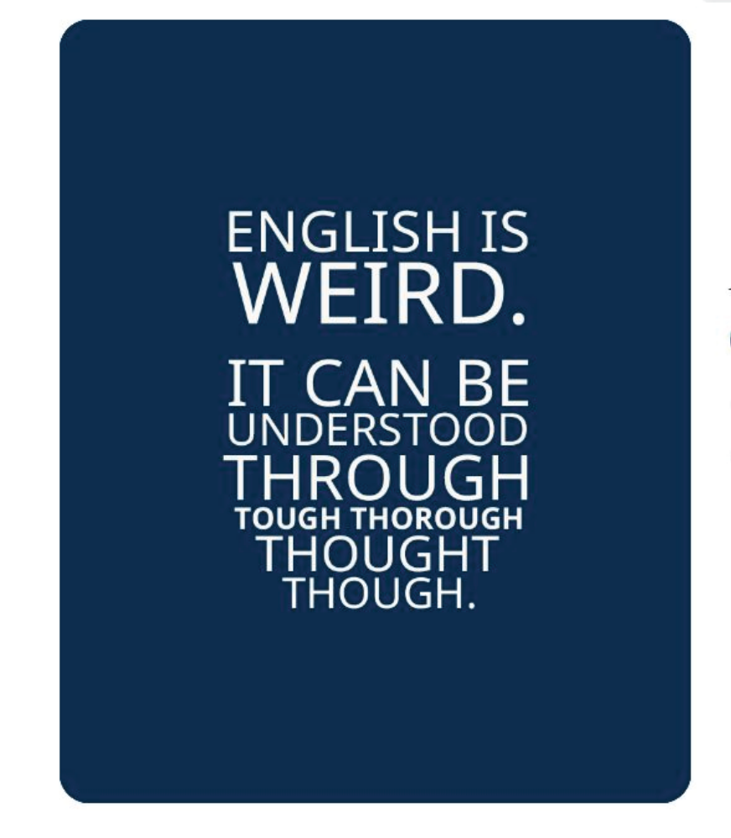
Questão 35

Slide 8
QUESTÃO 35
Em relação à compreensão do idioma inglês, o texto ilustra
(A) a disparidade entre ortografia e fonética.
(B) circunstâncias de tempo e modo.
(C) a ordem dos elementos na oração.
(D) um conjunto de locuções adjetivas.
(E) um problema de concordância verbal.

Slide 9
TEXTO PARA AS QUESTÕES 68 a 70
The expression “dark doldrums” chills the hearts of renewable-energy engineers, who use it to refer to the lulls when solar panels and wind turbines are thwarted by clouds, night, or still air. On a bright, cloudless day, a solar farm can generate prodigious amounts of electricity. But at night solar cells do little, and in calm air turbines sit useless.
The dark doldrums make it difficult for us to rely totally on renewable energy. Power companies need to plan not just for individual storms or windless nights but for difficulties that can stretch for days. Last year, Europe experienced a weekslong “wind drought,” and in 2006 Hawaii endured six weeks of consecutive rainy days. On a smaller scale, communities that want to go all-renewable need to fill the gaps. The obvious solution is batteries, which power everything from mobile phones to electric vehicles; they are relatively inexpensive to make and getting cheaper. But typical models exhaust their stored energy after only three or four hours of maximum output, and — as every smartphone owner knows — their capacity dwindles with each recharge. Moreover, it is expensive to collect enough batteries to cover longer discharges.

Slide 10
TEXTO PARA AS QUESTÕES 68 a 70
We already have one kind of renewable energy storage: more than ninety per cent of the world’s energy-storage capacity is in reservoirs, as part of a technology called pumped-storage hydropower, used to smooth out sharp increases in electricity demand. Motors pump water uphill from a river or a reservoir to a higher reservoir; when the water is released downhill, it spins a turbine, generating power. A pumped-hydro installation is like a giant, permanent battery, charged when water is pumped uphill and depleted as it flows down. Some countries are expanding their use of pumped hydro, but the right geography is hard to find, permits are difficult to obtain, and construction is slow and expensive. The hunt is on for new approaches to energy storage.

Slide 11
QUESTÃO 68
No texto, a expressão “dark doldrums” descreve
(A) as mudanças climáticas atribuídas ao fenômeno de aquecimento global.
(B) os altos custos implicados na construção de fontes de energia renovável.
(C) os debates entre ecologistas e defensores do emprego de energia nuclear.
(D) os períodos de inatividade de geradores de energia como painéis solares.
(E) as dificuldades encontradas por comunidades rurais para distribuir eletricidade.

Slide 12
QUESTÃO 69
Na frase “But typical models exhaust their stored energy after only three or four hours of maximum output, and — as every smartphone owner knows —their capacity dwindles with each recharge.” (2º parágrafo), “dwindles” poderia ser substituído, sem prejuízo de sentido, por
(A) improves.
(B) directs.
(C) propagates.
(D) breaks.
(E) decreases.

Slide 13
QUESTÃO 70
Segundo o texto, quando a geração de energia por células solares ou turbinas eólicas é insuficiente para atender à demanda, uma fonte de energia alternativa envolveria a conversão de
(A) energia nuclear em elétrica.
(B) energia mecânica em térmica.
(C) energia mecânica em elétrica.
(D) energia solar em mecânica.
(E) energia química em elétrica.

Slide 14
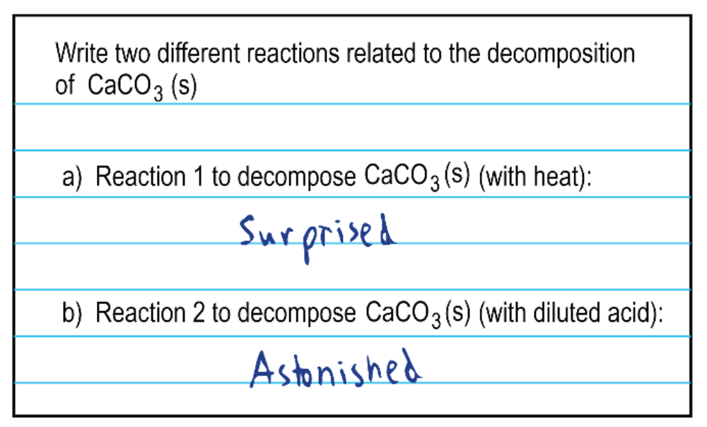
Questão 75

Slide 15
QUESTÃO 75
No meme, a inadequação da resposta à questão está baseada no efeito de sentido proveniente da presença de
(A) metáfora.
(B) trocadilho.
(C) sinédoque.
(D) eufemismo.
(E) comparação.

